Slide 1
Search
and Virtual
Documents
Notes:
Place the audio notes for this slide here

Slide 2

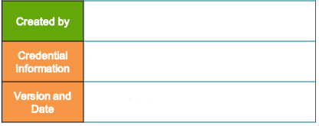
Karthik Juttu (184017)
Enterprise Content Management competence
V 0.1, 16th February 2018

Slide 3
Agenda
Search tools
Simple Search
Advance Search
Save and re-use Search
Search preference configuration
Difference between index and non-index searches

Slide 4
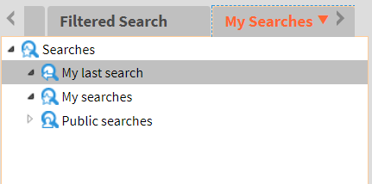
Search Tools
Type of search available in D2.

Slide 5
Search Tools
Additionally, there are several user preference options related to search are available to user.
Display column
Favorite repositories
Default search locations

Slide 6
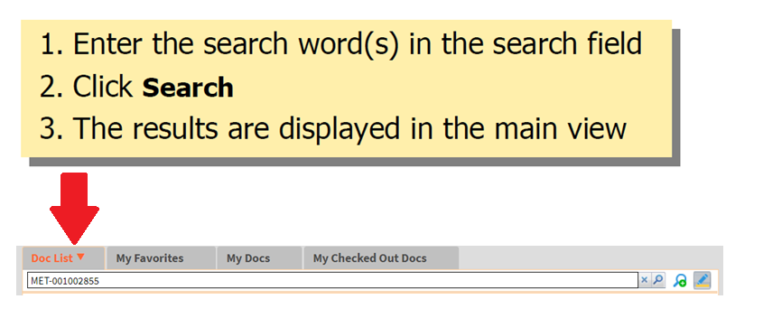
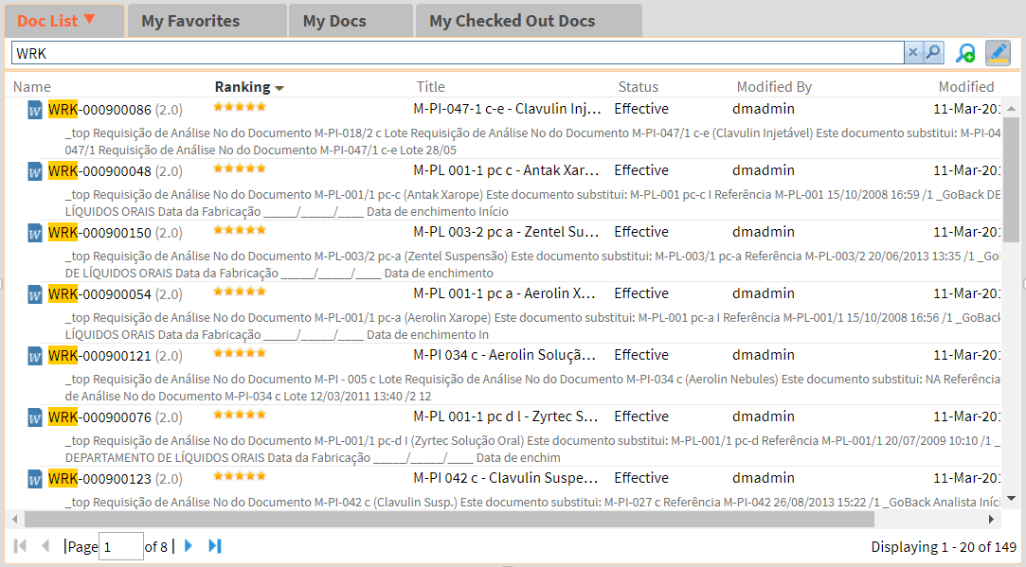
Performing Simple search
To perform simple search in WebTop, please use the steps below.
Search Result:

Slide 7
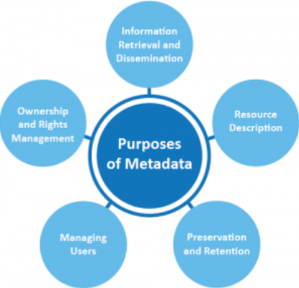
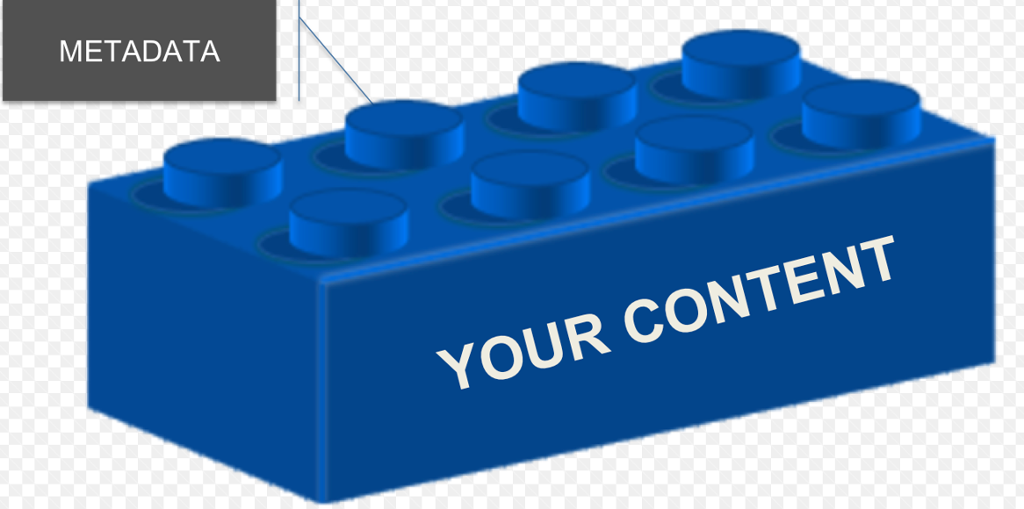
Documentum Search
What can be searched in Documentum?
Object properties - Metadata
Content files(if full-text indexing is enabled)

Slide 8

Search Index
If Full-Text indexing is enabled, The content become searchable when it is indexed by the Index Server
Index are associated with the particular repository
Attributes and content files are associated with dm_sysobject and its sub-types
Enables rapid searching of exact text strings in the content file and the attribute file
Points to remember:
Attributes are always searchable irrespective of the index server configuration

Slide 9

Simple search
Simple search is a single field search that matches the search string with indexed documents and its metadata
An administrator configures which properties quality for the simple search

Slide 10
Simple Search
Simple search is a single field search that matches the search string with indexed documents and its metadata
An administrator configures which properties quality for the simple search
Note:
Incase, if a exceptional state is defined for a normal state, one can suspend the document progress by simply moving the object to the exceptional state and vise versa.

Slide 11
Virtual Documents

Slide 12
Agenda
Features and Benefits of Virtual Document
Virtual Document Creation
Add Component to Virtual Document
Snapshot Creation

Slide 13
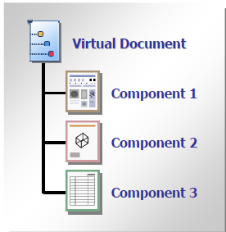
Virtual Document
Virtual Document is a Container Document
Contains any dm_sysobject or subtypes of dm_sysobject
Can contain simple documents or other virtual documents
Cannot contain folders, cabinets or subtypes of folders
The components of a Virtual Document are arranged:
In a hierarchy
In a specific order
For each component of a virtual document, the Content Server creates a dmr_containment object that stores information about the component's membership in a virtual document
Business Benefit: Virtual Documents allow multiple contributors to add and modify content belonging to simple or larger document structure

Slide 14
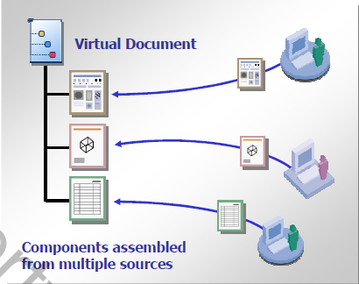
Virtual Document Benefits
Virtual documents provide a way to combine multiple documents in multiple formats into a single document
Even though component documents are grouped together in a virtual document, components are still individual object in the repository
Can be edited and managed independently of their virtual document association
A virtual document can contain a document or component that belongs to other virtual documents.
Virtual documents allow you to save and retrieve snapshots that reflect the state of all components of a virtual document at a specific point in time
When a component document is update, every virtual document it is in will reflect these changes
A virtual document provides a solution for managing and editing large, Collaborative content files such as a book or a web site

Slide 15
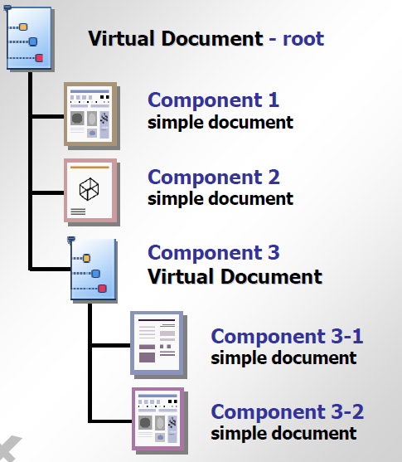
Parents and Children
A virtual document is created by:
Converting a simple document into a virtual document
Adding component documents to the virtual document
Each component can be a simple document or another virtual document with its own children
Within a virtual document:
Each child can have only one parent
Each parent can have many children

Slide 16
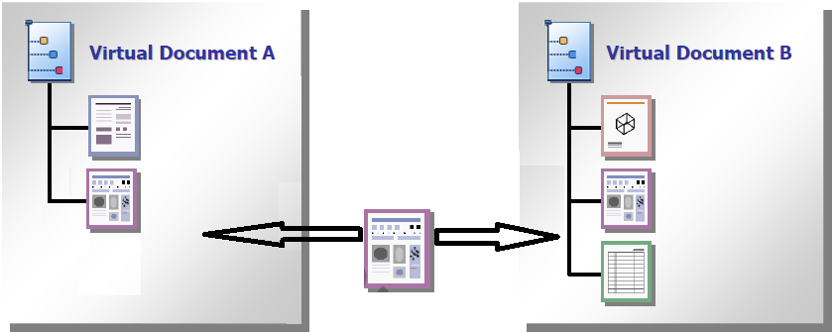
Linked Documents
Virtual documents are maintained by the Content server as internal links between documents
Adding a component to a virtual document does not duplicate or alter the component document
A document can be a component of multiple virtual documents
For each component of a virtual document, the Content Server creates a dmr_containment object that stores information about the component's membership in a virtual document

Slide 17
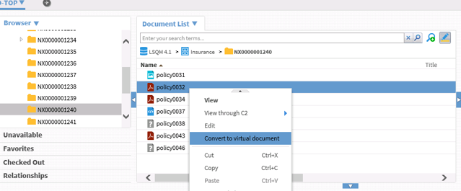
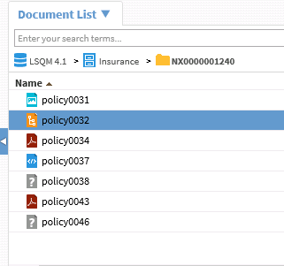
Creating a Virtual Document
The first step to creating a virtual document in D2 is to convert an existing simple document to a virtual document
Select the target document
Right click and select “convert to virtual document”.
The document is converted to Virtual Document and appears with the virtual document icon.

Slide 18
A New Virtual Document
In the Document list widget, right-click the virtual document and select Display Virtual Document. We can able to view a virtual document in the virtual document widget.
Convert a virtual document back to content:
In the virtual document widget, right-click the parent you want converted back to a simple content and select Convert to a Simple Document.
You can only convert a virtual document parent to simple content if it contains no children/Components.

Slide 19
Adding Components
Drag and drop content from the Document list widget to a virtual document opened in the Virtual Document widget.
Insert a virtual document with properties inherited from a template:
In the virtual document widget, right-click content under which you want to add the components of a virtual document and select Insert inherited component.
Navigate to and select the virtual document.
Select the virtual document template to apply its properties and components.
Click OK.
View a component within a virtual document:
In the virtual document widget, right-click the component and select View.
Note: From within the Virtual document widget, you can display a snapshot only by right-clicking the snapshot in a doclist widget and then selecting Display snapshot.
Convert a component to a child virtual document:
Drag and drop content from the Document list widget or from within the virtual document widget on top of a component within the virtual document widget.
D2 converts the component to a virtual document.

Slide 20
Working on Virtual Documents
Editing components of virtual documents:
In the virtual document widget, right-click the component and select Edit.
Deleting virtual document:
In the Document list widget, right-click the virtual document and select Delete.
If you have D2 Bin installed, you can restore a virtual document root from the recycle bin. D2 does not restore components that were added to the virtual document (only root document can be restored).
Remove a component from a virtual document:
In the virtual document widget, right-click on the component and select Delete Component.
Set the version of a component to use with the virtual document:
In the virtual document widget, right-click the component and select Set binding version.
Select the version of the content to be used for the virtual document.
Click OK.

Slide 21
Working on Virtual Documents
Checking out and checking in a virtual document:
Select the virtual document, then navigate to Content > Checkin or Content > Checkout from the menu bar.
When you cancel the checkout of a virtual document with no child components by navigating to Content> Cancel checkout from the menu bar, the virtual document is reverted to a simple document.

Slide 22
Snapshot Creation:
Creating a snapshot of the virtual document:
In the virtual document widget, click Create Snapshot.
Type a Title.
Click OK.
Viewing snapshot of the virtual document:
In the doclist widget, right-click the virtual document snapshot and select Display snapshot.
When viewing the snapshot of a Virtual Document in the Virtual Document widget, it appears disabled because you cannot edit it.
Note:- From within the virtual document widget, a snapshot cannot be displayed. If you have D2 Bin installed, you can delete virtual document snapshots, but you cannot view them in the recycle bin.
Delete a snapshot of the virtual document:
In the doclist widget, right-click the virtual document snapshot and select Delete.

Slide 23
Icons Used in D2:
Icon | Button Name | Description
 | Expand All | Expand all trees in the selected virtual document.
 | Collapse All | Collapse all trees in the selected virtual document.
 | Move Up | Move the selected component up. You can also reorder component by dragging and dropping.
 | Move Down | Move the selected component down. You can also reorder component by dragging and dropping.
 | Show Virtual Document Number | Switch between an unordered list or an ordered list.
 | Show Virtual Document Version Number | Show or hide the version number of each component.
 | Create Snapshot | Create a snapshot of the virtual document.

Slide 24
Converting Folder Structure to Virtual Document
You can create a virtual document from an existing folder along with its content and subfolders structure. The virtual document automatically selects the parent folder as a virtual document root folder.
The root folder type and its properties are created based on the folder structure conversion configuration. If the virtual document root folder is included in the conversion, then its location is ignored during the current folder conversion.
Note: This feature is available only if the folder structure conversion is configured for the user.
Navigate to Content > Convert to Virtual Document from the menu bar.
Alternatively, you can select Convert to virtual document from the folder and cabinet context menu.
On the Fill creation profile page:
Note: The Creation profile will be populated based on the configuration settings for the user.
Select an Object Type from the list box.
Click Next.
On the Edit properties page, fill out the properties form.
Click Convert to Virtual Document to convert the selected folder and its content to the virtual document.

Slide 25
You have successfully completed
Notes:
Place the audio notes for this slide here

